Slide 1
AI-Native Operating Platform
For maritime
Unify workflows, ship-shore collaboration, remote workforce management for safety, compliance, efficiency and welfare

Slide 2
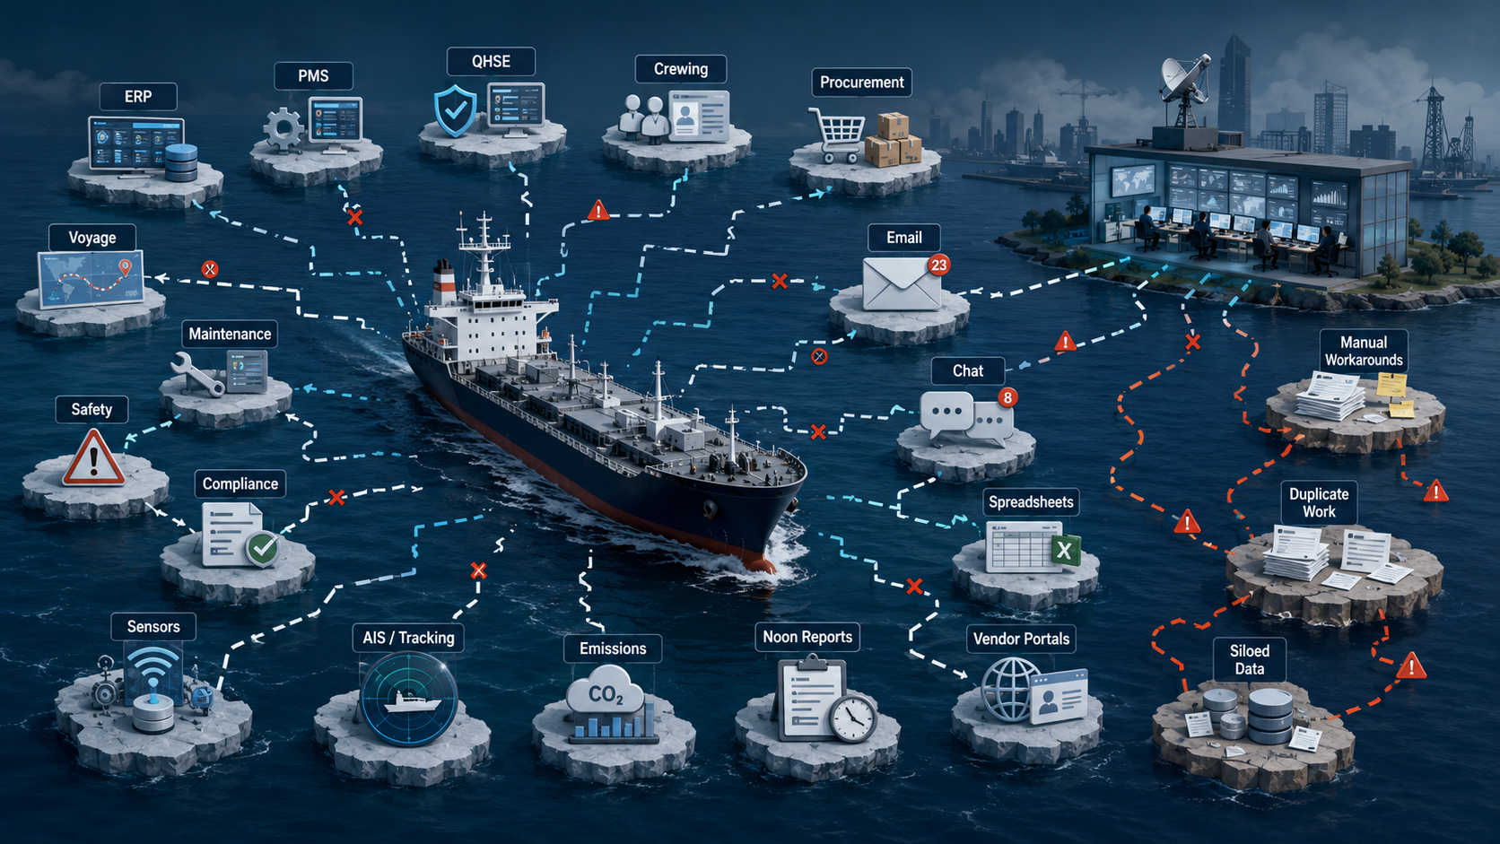

Slide 3
Maritime operations remain fragmented across systems, data, workflows and stakeholder groups.

Slide 4
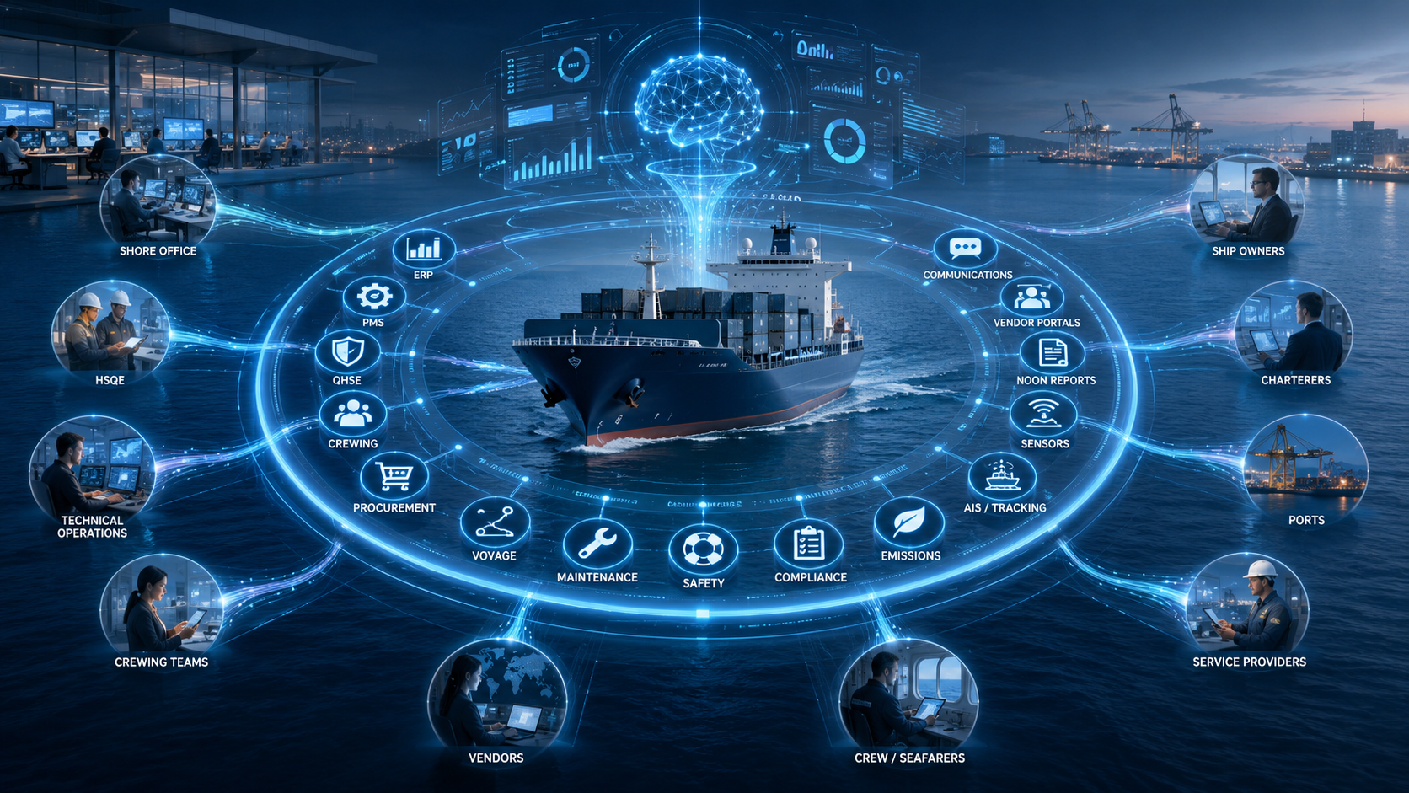

Slide 5
FrontM is changing that, one maritime workflow at a time, with a modular, integrated and scalable operating platform.

Slide 6
Trusted by
Fleet Operators
Maritime Ecosystem Organisations
Systems Integrators
Maritime Service Providers
Logos

Slide 7
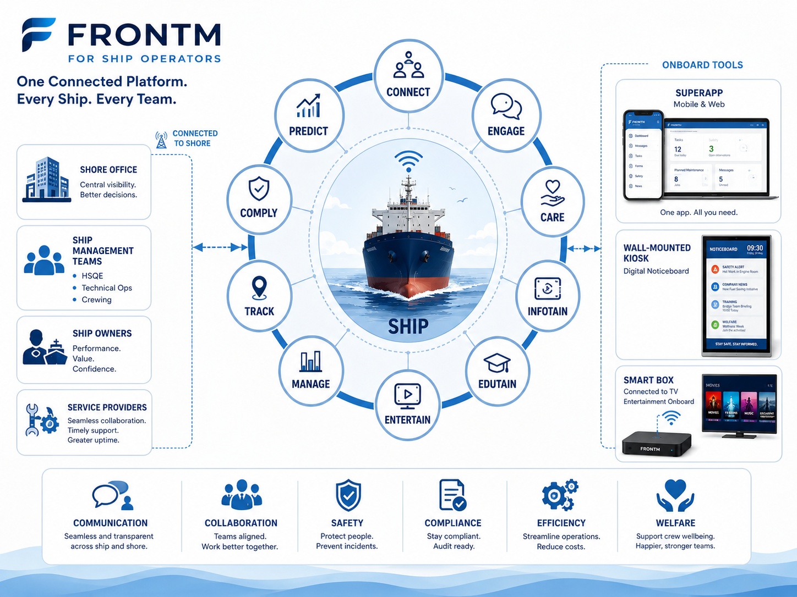
Show the modules as per Chirag’s existing design

Slide 8
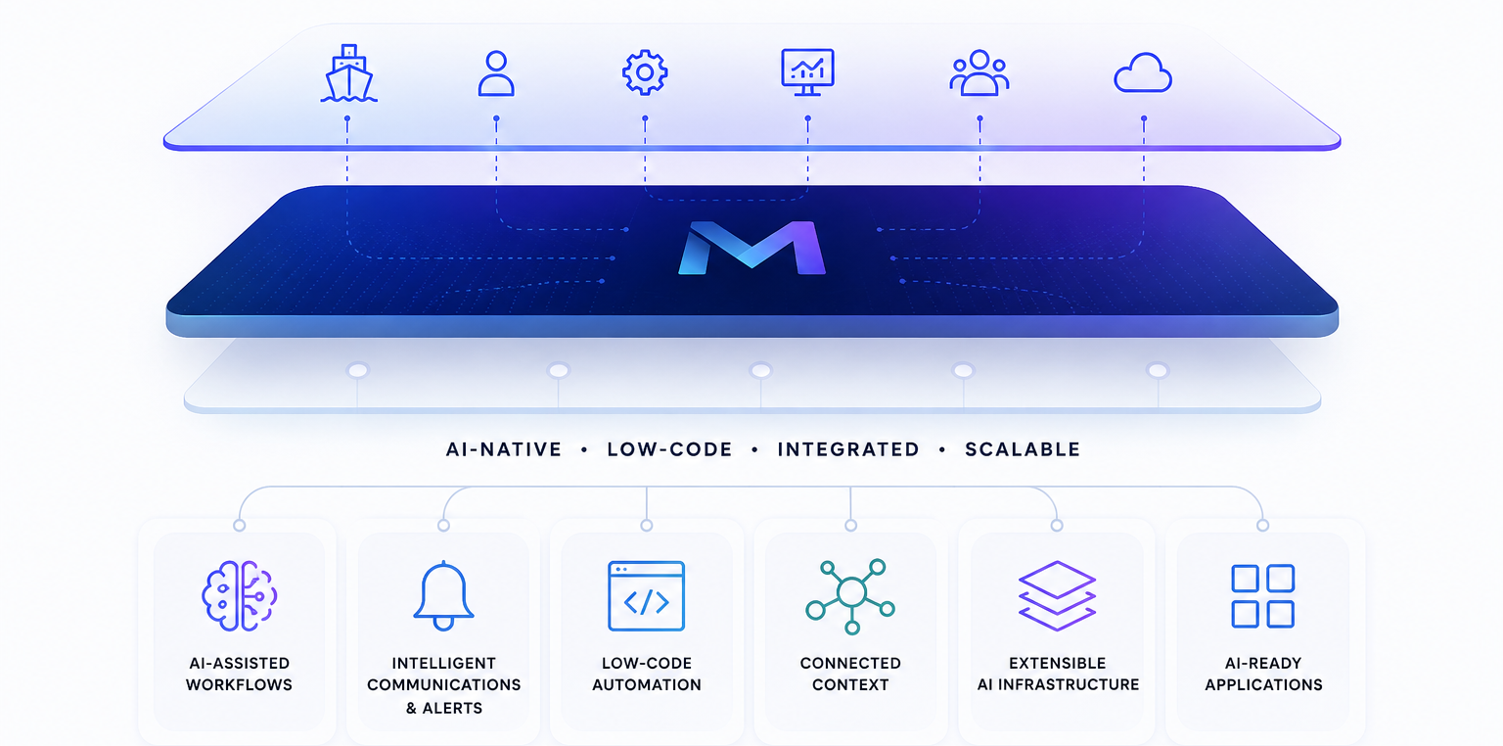
FrontM.ai is designed as the Maritime’s most comprehensive intelligent operational infrastructure layer to ACCELERATE DIGITALISATION

Slide 9
Built to Accelerate Maritime Digitalisation Maritime organisations have no shortage of ideas to improve operations. The challenge is turning those ideas into practical digital solutions quickly, without creating more fragmented tools. FrontM.ai gives ship managers, owners and maritime service providers one flexible foundation to launch new apps, workflows and digital services across vessels, offices, crew and partners. From safety communication and compliance workflows to crew engagement, AI agents, process automation and ship-shore collaboration, FrontM.ai helps maritime teams move faster, work smarter and keep improving. A simpler way to build the future of maritime operations.

Slide 10
Show the Solutions for different departments as per Chirag’s existing design

Slide 11
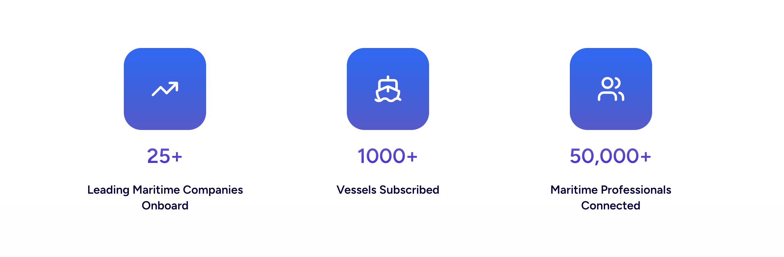
IMPACT make it big and bold

Slide 12
Blogs Carousal of blogs

Slide 13
Testimonials slider

Slide 14
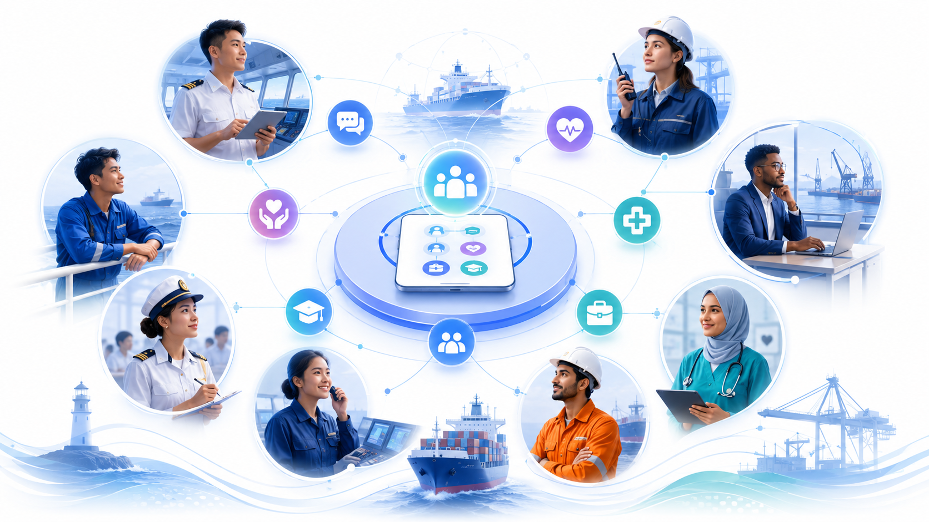
B2C section We are committed to connecting everyone in maritime Because together, we can make life at sea safer, smarter and more rewarding. onship is FrontM’s community platform for seafarers, cadets and maritime professionals, created to bring people, support, learning and opportunities closer together. A stronger maritime workforce creates a stronger maritime industry. Join the onship community

Slide 15
Inspiring ecosystem picture

Slide 16
Footer

Slide 17
WEBSITE RENDERED…

Slide 18
1

Slide 19
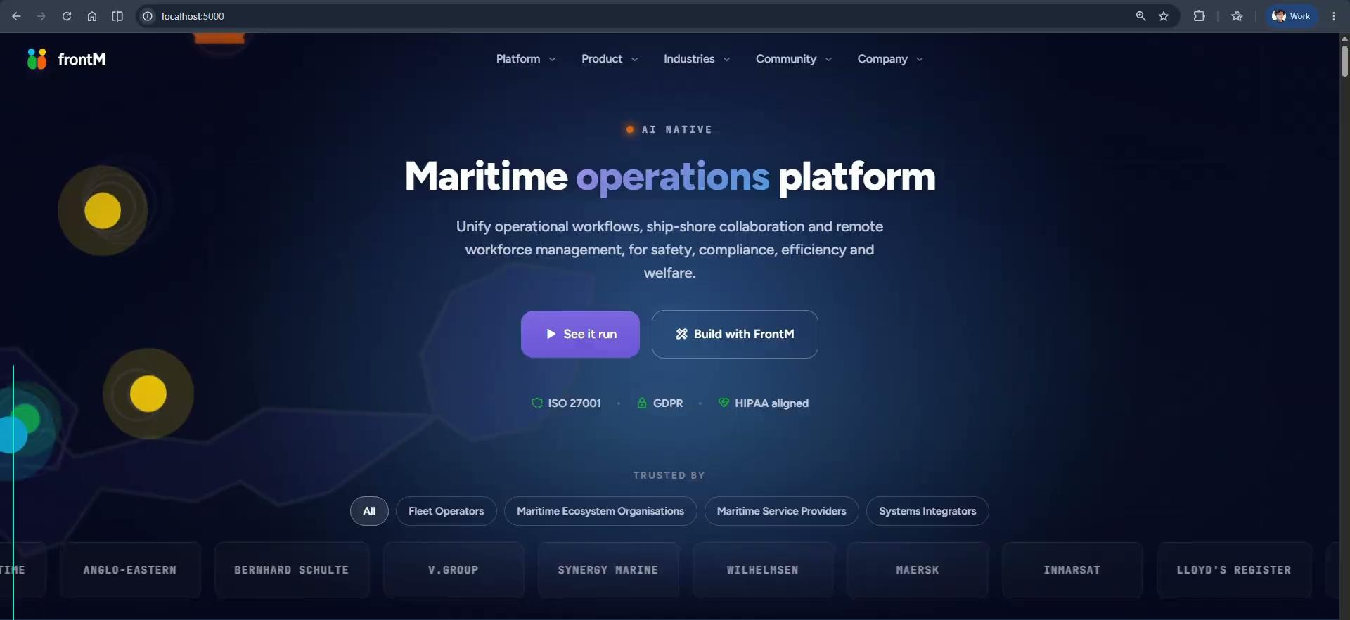

Slide 20
6 and 2,3,4,5

Slide 21
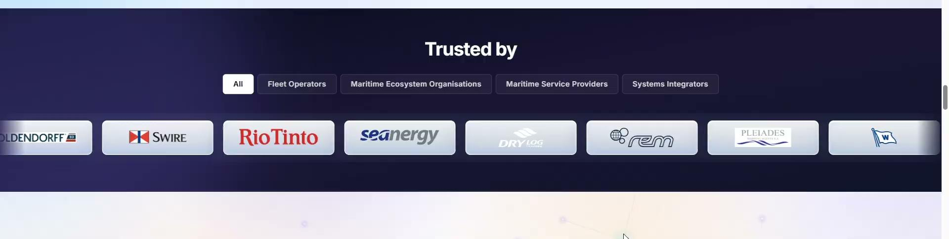
6

Slide 22
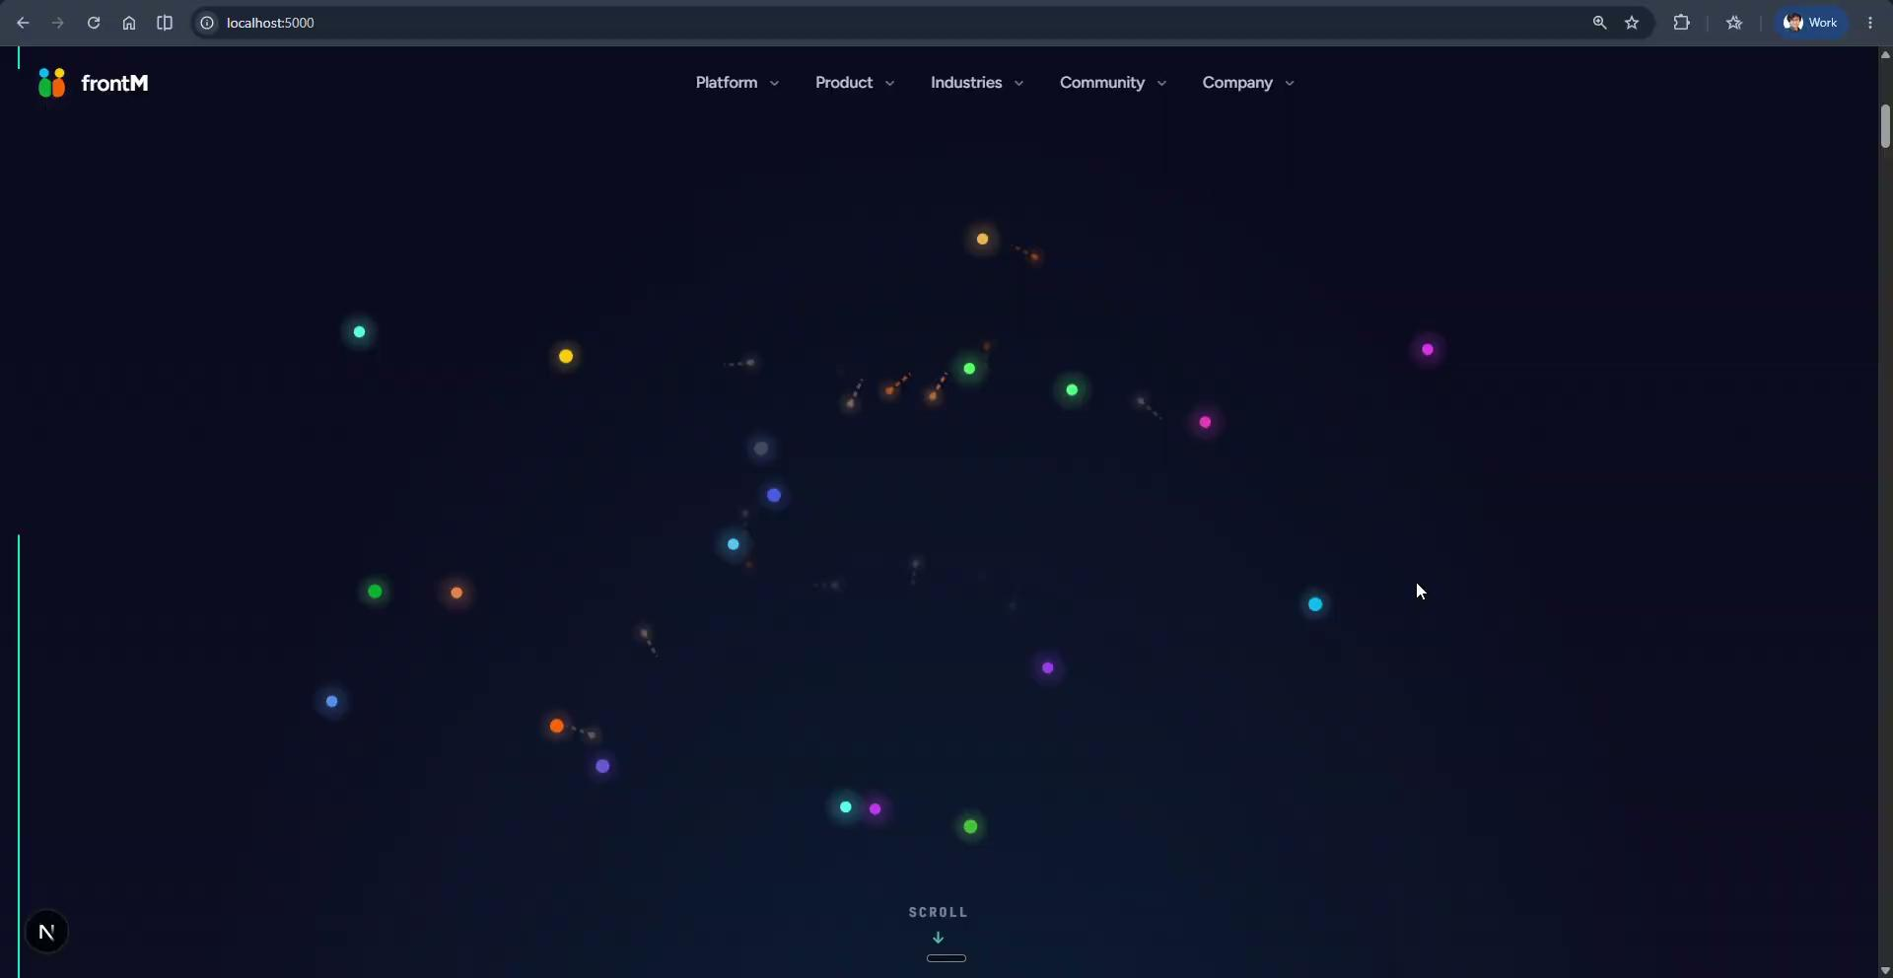
2,3,4,5

Slide 23
[07] Modules 01

Slide 24
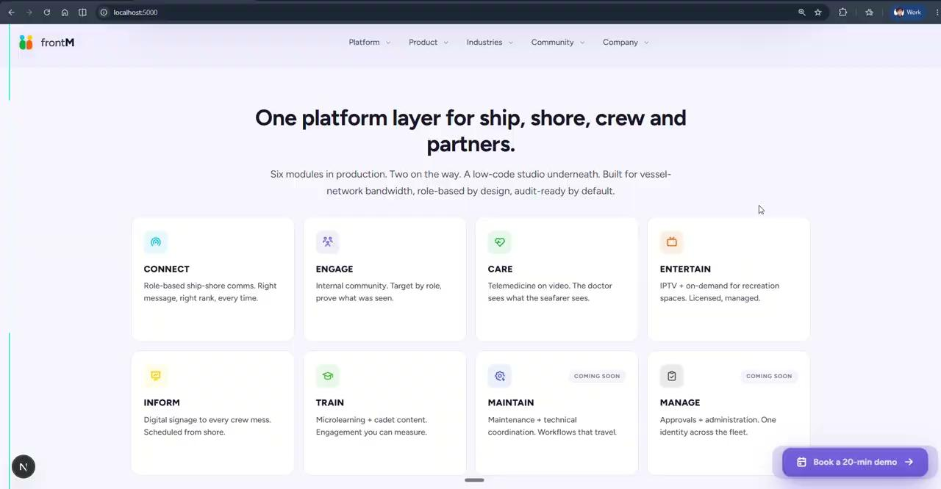

Slide 25
[07] Modules 02

Slide 26
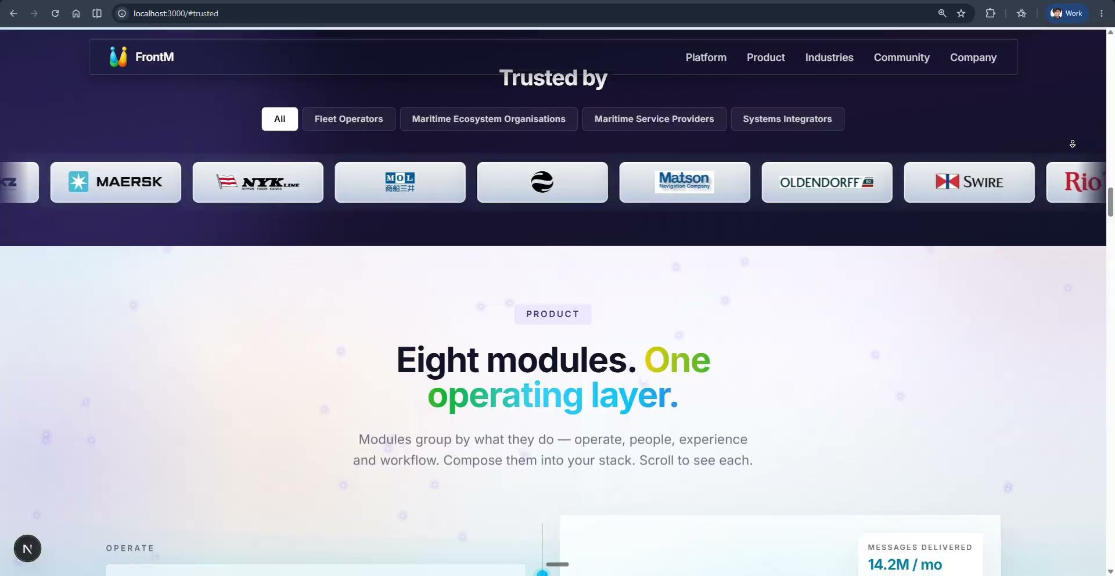

Slide 27
[08] Platform

Slide 28
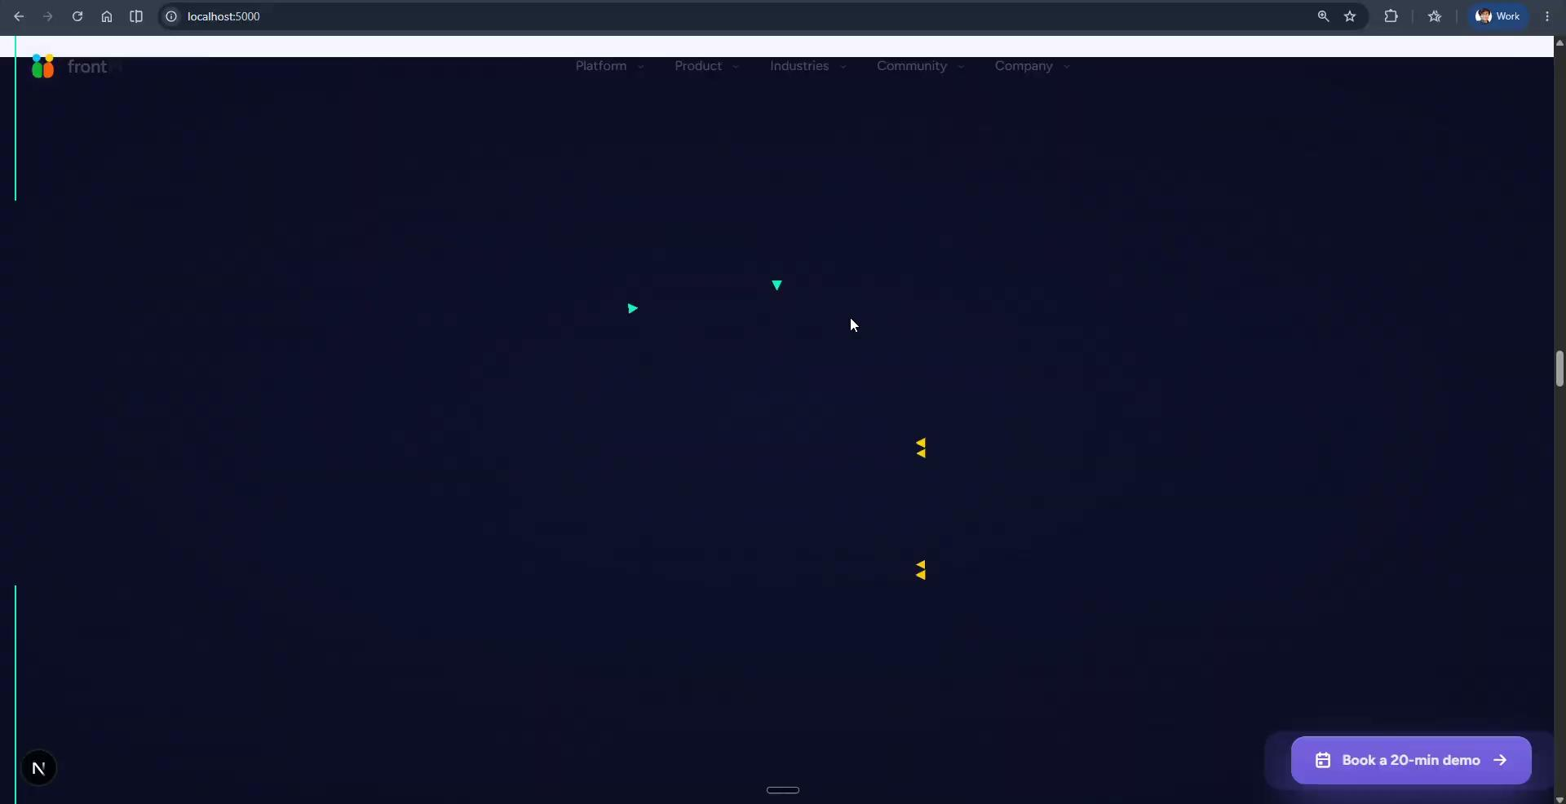

Slide 29
[09] After Platform

Slide 30
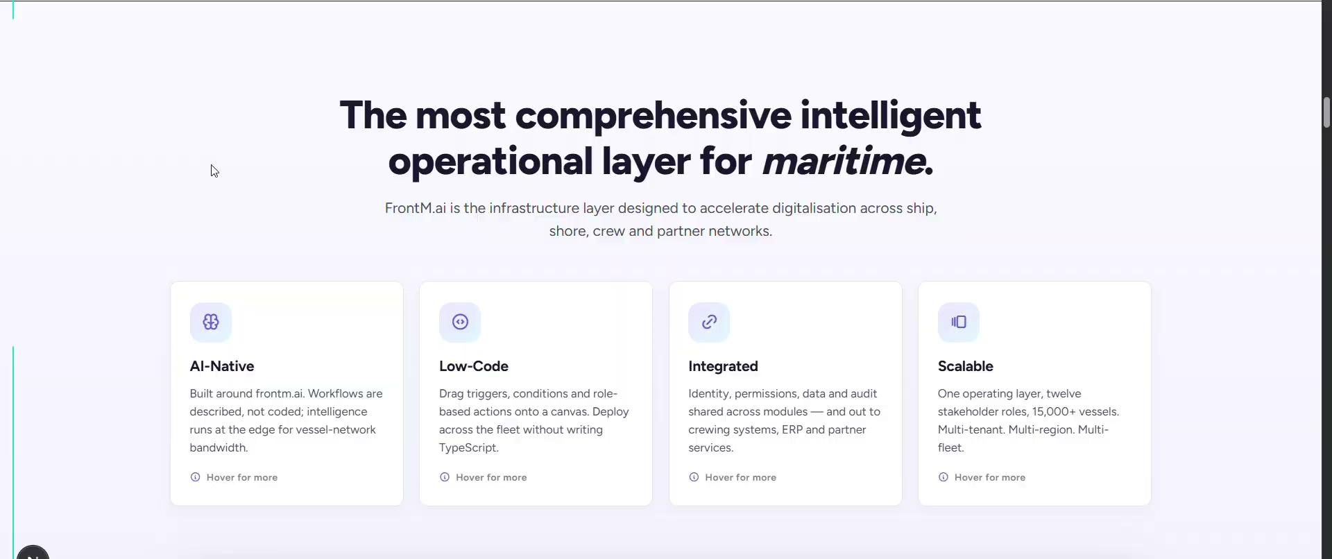

Slide 31
[10] Solutions by department 01

Slide 32
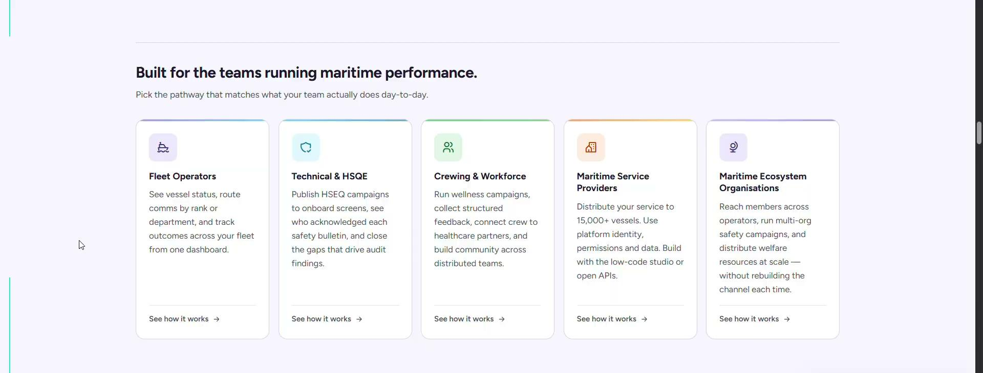

Slide 33
[10] Solutions by department 02

Slide 34
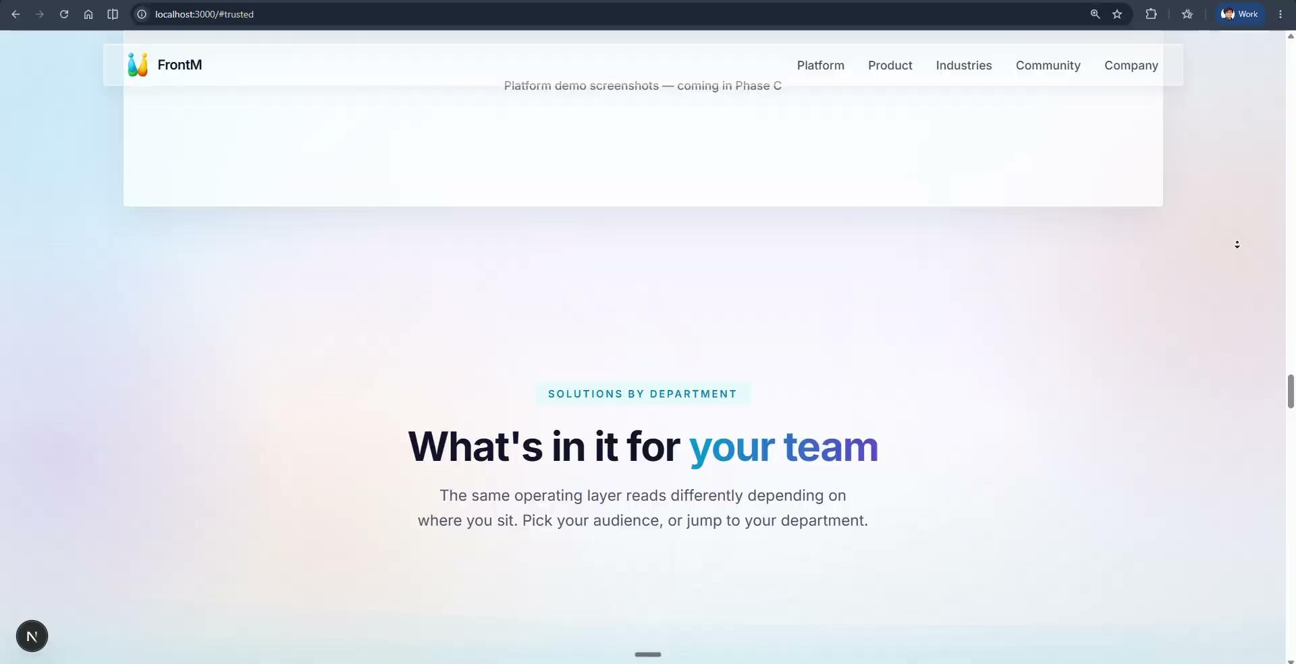

Slide 35
[11] IMPACT + CTA to BOOK A DEMO

Slide 36
